Slide 1
Data Models
15

Slide 2
Contents
Data Models
Object oriented model

Slide 3
Object oriented model
In this both data and their relationship are organised or contained in a single structure known as object.
Object includes information about relationship between the facts within the object, as well as information about relationship with other objects.
It is also said to be semantic data model.

Slide 4
Components of Object Oriented Data Model
An object is the abstraction of the real world entity and an object represents only one occurrence of entity.
Attributes: It describes the property of an object.
Student : Object/Class
SID, SNAME, SADD, Phone: Properties/ Attributes

Slide 5
Components of Object Oriented Data Model
Class: Objects that are similar in characteristics are grouped in class.
So large is a collection of similar objects with shared structure(attributes) and behavior (method).
Method: Method represent a real world action such as finding a selected student name, changing student name, or printing a student address.

Slide 6
Components of Object Oriented Data Model

Slide 7
Components of Object Oriented Data Model
Classes are organised in a class hierarchy and it resembles an upside down tree in which class has only one parent(Head).
Inheritance: It is an object ability to inherit the attributes and methods (messages) of the class above it.

Slide 8
Components of Object Oriented Data Model

Slide 9
Need of Object Oriented Data Model
To represent the complex real world problems there was a need for a data model that is closely related to real world. Object Oriented Data Model represents the real world problems easily.
In Object Oriented Data Model, data and their relationships are contained in a single structure which is referred as object in this data model. In this, real world problems are represented as objects with different attributes. All objects have multiple relationships between them. Basically, it is combination of Object Oriented programming and Relational Database Model
Object Oriented Data Model
= Combination of Object Oriented Programming + Relational database model

Slide 10
Need of Object Oriented Data Model
To represent the complex real world problems there was a need for a data model that is closely related to real world. Object Oriented Data Model represents the real world problems easily.
In Object Oriented Data Model, data and their relationships are contained in a single structure which is referred as object in this data model. In this, real world problems are represented as objects with different attributes. All objects have multiple relationships between them. Basically, it is combination of Object Oriented programming and Relational Database Model
Object Oriented Data Model
= Combination of Object Oriented Programming + Relational database model

Slide 11
Need of Object Oriented Data Model
In the object oriented data model (OODM), both data and their relationships are contained in a single structure known as an object.
In turn, the OODM is the basis for the object-oriented database management system (OODBMS).

Slide 12
Notes
An object is an abstraction of a real-world entity. In general terms, an object may be considered equivalent to an ER model’s entity. More precisely, an object represents only one occurrence of an entity. (The object’s semantic content is defined through several of the items in this list.)
Attributes describe the properties of an object. For example, a PERSON object includes the attributes Name, Social Security Number, and Date of Birth.
Objects that share similar characteristics are grouped in classes. A class is a collection of similar objects with shared structure (attributes) and behavior (methods). In a general sense, a class resembles the ER model’s entity set. However, a class is different from an entity set in that it contains a set of procedures known as methods. A class’s method represents a real-world action such as finding a selected PERSON’s name, changing a PERSON’s name, or printing a PERSON’s address. In other words, methods are the equivalent of procedures in traditional programming languages. In OO terms, methods define an object’s behavior.
Classes are organized in a class hierarchy. The class hierarchy resembles an upside-down tree in which each class has only one parent. For example, the CUSTOMER class and the EMPLOYEE class share a parent PERSON class. (Note the similarity to the hierarchical data model in this respect.)
Inheritance is the ability of an object within the class hierarchy to inherit the attributes and methods of the classes above it. For example, two classes, CUSTOMER and EMPLOYEE, can be created as subclasses from the class PERSON. In this case, CUSTOMER and EMPLOYEE will inherit all attributes and methods from PERSON.

Slide 13
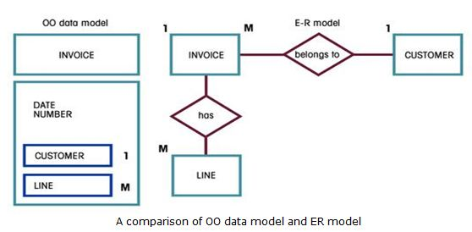
Notes

Slide 14
Advantages and Disadvantages
Advantages of Object Oriented Data Model
Add semantic content
Visual presentation includes semantic content
Database integrity
Both structural and data independence
Disadvantages of Object Oriented Data Model
Lack of OODM standards
Complex navigational data access
Steep learning curve
High system overhead slows transactions

Slide 15


